Slide 1
CUIIC WEBINAR
PRESENTATION TITLE IN THIS SPACE HERE
[Name of Presenter]

Slide 2
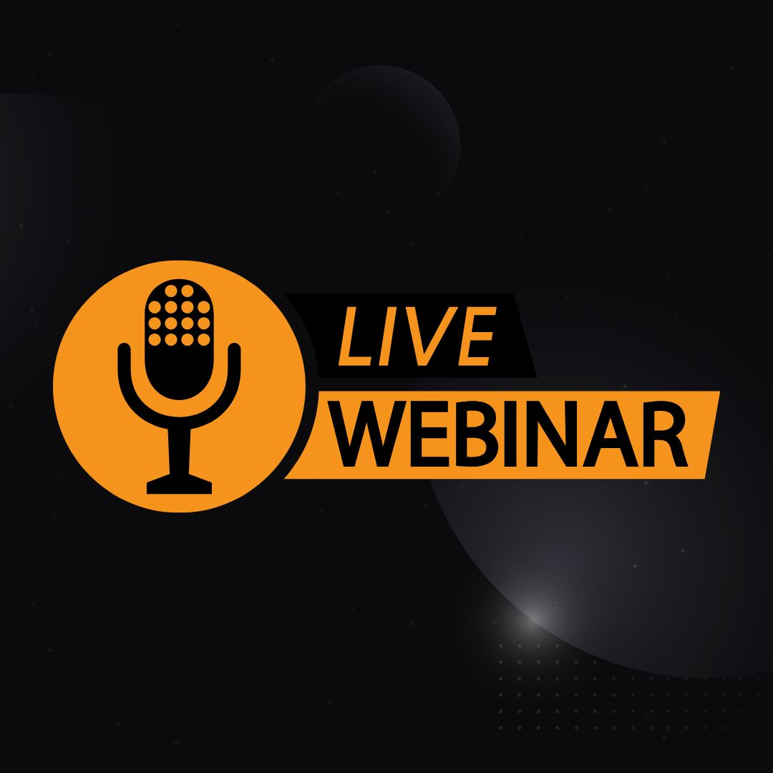
CUIIC Webinars
Presented by the Canadian Underground Infrastructure Innovation Centre (CUIIC).
Complimentary Bi-Weekly Live Webinar Series.
September 15, 2022 – December 8, 2022.
Visit www.cuiic.ca for the full schedule.

Slide 3
CUIIC
A cross-Canada hub for research and education in underground infrastructure.
Located at the University of Alberta.
CUIIC is a membership based organization that involves stakeholders – including municipalities, contractors, owners, and others – to identify pressing issues facing the underground sector.

Slide 4
CUIIC
CUIIC stakeholders represent all underground infrastructure domains including water, wastewater, transportation, gas distribution, energy, power, and telecommunications.
These sectors face similar challenges related to the construction and maintenance of underground infrastructure.

Slide 5
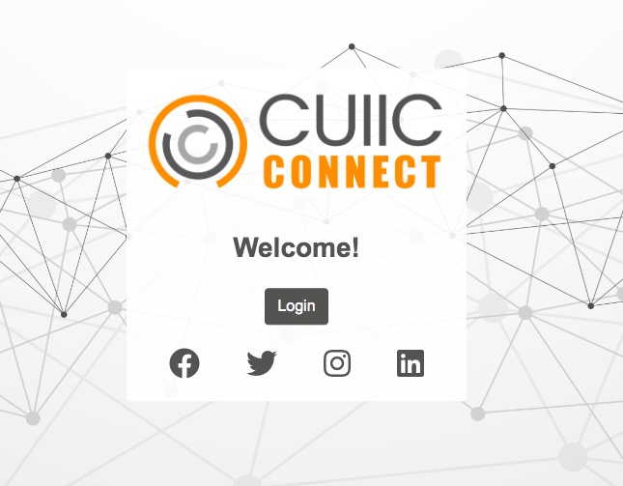
CUIIC Membership
Membership is open to manufacturers, suppliers, contractors, consultants, utilities, municipalities, and non-profit agencies.
Become an official research partner with the University of Alberta.
Access to CUIIC Connect Groups and Forum.
Visit www.cuiic.ca/membership to learn more.

Slide 6
Introduction
Name, Title, Company
Short Bio
Headshot

Slide 7
Presentation Overview

Slide 8
Insert Title/Topic Here
Insert Content Here
Add image here
IMAGE CREDIT: NAME HERE

Slide 9
Insert Title/Topic Here

Slide 10
Insert Title/Topic Here
Insert Image Here
Insert Image Here
Insert Image Here
EXAMPLE.1
EXAMPLE.2
EXAMPLE.3
Insert Content Here
Insert Content Here
Insert Content Here

Slide 11
Insert Title/Topic Here
Insert Content Here

Slide 12
Insert Title/Topic Here
Insert Subheading Here

Slide 13
Insert Title/Topic Here
Insert Content Here
Insert Content Here
Insert Content Here
Insert Content Here
Insert Graph/Data Table Here

Slide 14
Insert Title/Topic Here
Insert Content Here
Insert Content Here
Insert Content Here

Slide 15
Insert Title/Topic Here

Slide 16
Insert Title/Topic Here
Insert Image Here
“Insert Quote or Content Here”

Slide 17
Questions?

Slide 18
CUIIC Webinar Schedule
Bi-Weekly | Thursdays at 1:00 p.m. EST / 11:00 a.m. MST
Building Broadband Faster - Sept 15, 2022
Live Loads - Sept 29, 2022
Machine Learning Depiction Underground Infrastructure - Oct 13, 2022
Legal Issues Underground - Oct 27, 2022
Difficult Ground Conditions - Trenchless Contractor Perspective - Nov 10, 2022
Rural and Indigenous Infrastructure Challenges/Development - Nov 24, 2022

Slide 19
Thank You
[Speaker Name]
info@email.com
www.website.com
Logo
Learn more about the Canadian Underground Infrastructure Innovation Centre
or Become a Member by Visiting www.cuiic.ca.

